Slide 1
LESSON 18

Slide 2
Overview
of
Previous Lesson(s)

Slide 3
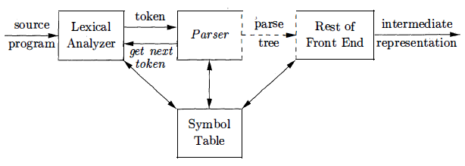
Over View
In our compiler model, the parser obtains a string of tokens from the lexical analyzer & verifies that the string of token names can be generated by the grammar for the source language.

Slide 4
Over View...
Trivial Approach: No Recovery
Print an error message when parsing cannot continue and then terminate parsing.
Panic-Mode Recovery
The parser discards input until it encounters a synchronizing token.
Phrase-Level Recovery
Locally replace some prefix of the remaining input by some string. Simple cases are exchanging ; with , and = with ==.
Error Productions
Include productions for common errors.
Global Correction
Change the input I to the closest correct input I' and produce the parse tree for I'.

Slide 5
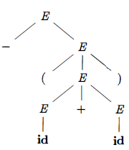
Over View...
A parse tree is a graphical representation of a derivation that filters out the order in which productions are applied to replace non-terminals
The leaves of a parse tree are labeled
by non-terminals or terminals and,
read from left to right constitute a sentential form, called the yield or frontier of the tree.

Slide 6
Over View...
A grammar that produces more than one parse tree for some sentence is said to be ambiguous
Alternatively, an ambiguous grammar is one that produces more than one leftmost derivation or more than one rightmost derivation for the same sentence.
Ex Grammar E → E + E | E * E | ( E ) | id
It is ambiguous because we have seen two parse trees for id + id * id

Slide 7
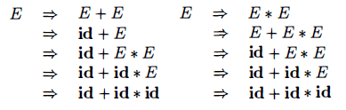
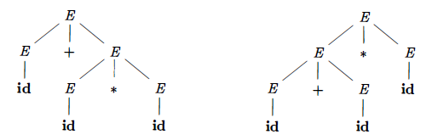
Over View...
There must be at least two leftmost derivations.
So two parse trees are

Slide 8
Over View...
Every construct described by a regular expression can be described by a grammar, but not vice-versa.
Alternatively, every regular language is a context-free language, but not vice-versa.
Why use regular expressions to define the lexical syntax of a language?
Reasons:
Separating the syntactic structure of a language into lexical and non-lexical parts provides a convenient way of modularizing the front end of a compiler into two manageable-sized components.

Slide 9
Over View...
The lexical rules of a language are frequently quite simple, and to describe them we do not need a notation as powerful as grammars.
Regular expressions generally provide a more concise and easier-to-understand notation for tokens than grammars.
More efficient lexical analyzers can be constructed automatically from regular expressions than from arbitrary grammars.
Regular expressions are most useful for describing the structure of constructs such as identifiers, constants, keywords, and white space

Slide 10

Over View...
An ambiguous grammar can be rewritten to eliminate the ambiguity.
Ex. Eliminating the ambiguity from the following dangling-else grammar:
Compound conditional statement
if E₁ then S₁ else if E₂ then S₂ else S₃

Slide 11
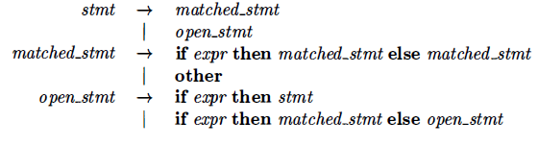
Over View...
Rewrite the dangling-else grammar with the idea:
A statement appearing between a then and an else must be matched that is, the interior statement must not end with an unmatched or open then.
A matched statement is either an if-then-else statement containing no open statements or it is any other kind of unconditional statement.

Slide 12
TODAY’S LESSON

Slide 13
Contents
Writing a Grammar
Lexical Vs Syntactic Analysis
Eliminating Ambiguity
Elimination of Left Recursion
Left Factoring
Non-Context-Free Language Constructs
Top Down Parsing
Recursive Decent Parsing
FIRST & FOLLOW
LL(1) Grammars

Slide 14
Elimination of Left Recursion
A grammar is left recursive if it has a non-terminal A such that there is a derivation A ⇒⁺ Aα for some string α
Top-down parsing methods cannot handle left-recursive grammars, so a transformation is needed to eliminate left recursion.
We already seen removal of Immediate left recursion i.e
A → Aα + β A → βA’
A’ → αA’ | ɛ

Slide 15
Elimination of Left Recursion..
Immediate left recursion can be eliminated by the following technique, which works for any number of A-productions.
A → Aα₁ | Aα₂ | … | Aα_{m} | β₁ | β₂ | … | β_{n}
Then the equivalent non-recursive grammar is
A → β₁A’ | β₂A’ | … | β_{n}A’
A’ → α₁A’ | α₂A’ | … | α_{m}A’ | ɛ
The non-terminal A generates the same strings as before but is no longer left recursive.

Slide 16
Elimination of Left Recursion...
This procedure eliminates all left recursion from the A and A' productions (provided no α_{i} is ɛ) , but it does not eliminate left recursion involving derivations of two or more steps.
Ex. Consider the grammar:
S → A a | b
A → A c | S d | ɛ
The non-terminal S is left recursive because S ⇒ Aa ⇒ Sda , but it is not immediately left recursive.

Slide 17
Elimination of Left Recursion...
Now we will discuss an algorithm that systematically eliminates left recursion from a grammar.
It is guaranteed to work if the grammar has no cycles or ɛ-productions.
INPUT:
Grammar G with no cycles or ɛ-productions.
OUTPUT:
An equivalent grammar with no left recursion. * The resulting non-left-recursive grammar may have ɛ-productions.

Slide 18
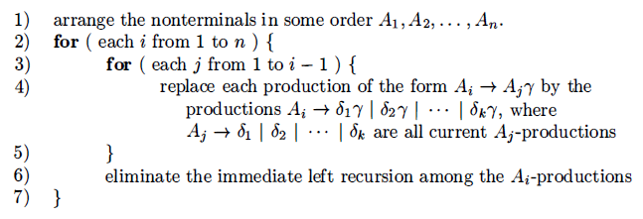
Elimination of Left Recursion...
METHOD:

Slide 19
Elimination of Left Recursion...
Ex. S → A a | b
A → A c | S d | ɛ
Technically, the algorithm is not guaranteed to work, because of the ɛ-production but in this case, the production A → ɛ turns out to be harmless.
We order the non-terminals S, A.
For i = 1 nothing happens, because there is no immediate left recursion among the S-productions.

Slide 20
Elimination of Left Recursion...
For i = 2 we substitute for S in A → S d to obtain the following A-productions.
A → A c | A a d | b d | ɛ
Eliminating the immediate left recursion among these A-productions yields the following grammar:
S → A a | b
A → b d A’ | A’
A’ → c A’ | a d A’ | ɛ

Slide 21

Left Factoring
Left factoring is a grammar transformation that is useful for producing a grammar suitable for predictive, or top-down, parsing.
If two productions with the same LHS have their RHS beginning with the same symbol (terminal or non-terminal), then the FIRST sets will not be disjoint so predictive parsing will be impossible
Top down parsing will be more difficult as a longer lookahead will be needed to decide which production to use.
Ex.

Slide 22
Left Factoring..
if A → αβ₁ | αβ₂ are two A-productions
Input begins with a nonempty string derived from α
We do not know whether to expand A to αβ₁ or αβ₂
However , we may defer the decision by expanding A to αA'
After seeing the input derived from α we expand
A' to β₁ or A' to β₂.
This is called left-factoring.
A → α A’
A' → β₁| β₂

Slide 23
Left Factoring…
INPUT: Grammar G.
OUTPUT: An equivalent left-factored grammar.
METHOD:
For each non-terminal A, find the longest prefix α common to two or more of its alternatives.
If α ≠ ɛ i.e., there is a nontrivial common prefix.
Replace all of the A-productions A → αβ₁ | αβ_{2 …} | αβ_{n} | γ by
A → α A’ | γ
A' → β₁| β₂| …. | β_{n}
γ represents all alternatives that do not begin with α

Slide 24


Left Factoring…
Ex Dangling else grammar:
Here i, t, and e stand for if, then, and else E and S stand for "conditional expression" and "statement."
Left-factored, this grammar becomes:

Slide 25
Non-CFL Constructs
Although grammars are powerful, but they are not all-powerful to specify all language constructs.
Lets see an example to understand this
The language in this example abstracts the problem of checking that identifiers are declared before they are used in a program.
The language consists of strings of the form wcw, where
the first w represents the declaration of an identifier w.
c represents an intervening program fragment.
the second w represents the use of the identifier.

Slide 26
Non-CFL Constructs..
The abstract language is L₁ = {wcw | w is in (a|b)*}
L₁ consists of all words composed of a repeated string of a's and b's separated by c, such as aabcaab.
The non-context- freedom of L₁ directly implies the non-context-freedom of programming languages like C and Java, which require declaration of identifiers before their use and which allow identifiers of arbitrary length.
For this reason, a grammar for C or Java does not distinguish among identifiers that are different character strings.

Slide 27
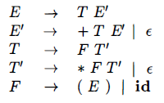
Top Down Parsing
Top-down parsing can be viewed as the problem of constructing a parse tree for the input string, starting from the root and creating the nodes of the parse tree in preorder (DFT).
If this is our grammar then the steps involved in construction of a parse tree are

Slide 28
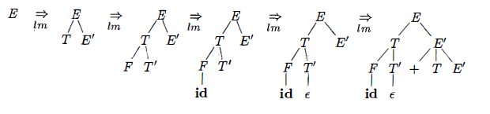
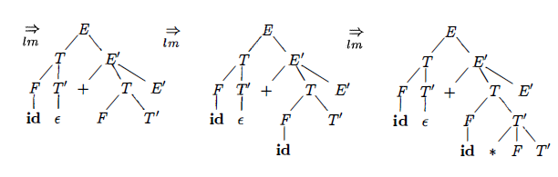
Top Down Parsing..
Top Down Parsing for id + id * id

Slide 29
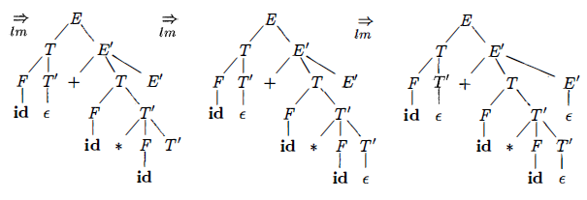
Top Down Parsing...
Consider a node labeled E' .
At the first E' node (in preorder) , the production E’ → +TE’ is chosen; at the second E’ node, the production E’ → ɛ is chosen.
A predictive parser can choose between E’-productions by looking at the next input symbol.

Slide 30
Top Down Parsing...
The class of grammars for which we can construct predictive parsers looking k symbols ahead in the input is sometimes called the LL(k) class.
LL parser is a top-down parser for a subset of the context-free grammars.
It parses the input from Left to right, and constructs a Leftmost derivation of the sentence.
LR parser constructs a rightmost derivation.

Slide 31
Recursive Decent Parsing
Recursive Descent Parsing
It is a top-down process in which the parser attempts to verify that the syntax of the input stream is correct as it is read from left to right.
A basic operation necessary for this involves reading characters from the input stream and matching then with terminals from the grammar that describes the syntax of the input.
Recursive descent parsers will look ahead one character and advance the input stream reading pointer when proper matches occur.

Slide 32
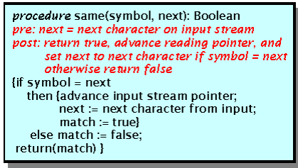
Recursive Decent Parsing..
The following procedure accomplishes matching and reading process.
The variable called 'next' looks ahead and always provides the next character that will be read from the input stream.
This feature is essential if we wish our parsers to be able to predict what is due to arrive as input.

Slide 33
Recursive Decent Parsing...
What a recursive descent parser actually does is to perform a depth-first search of the derivation tree for the string being parsed.
This provides the 'descent' portion of the name.
The 'recursive' portion comes from the parser's form, a collection of recursive procedures.
As our first example, consider the simple grammar
E → id + T
T → (E)
T → id

Slide 34
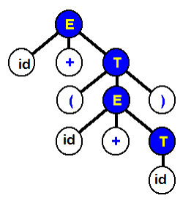
Recursive Decent Parsing...
Derivation tree for the expression id+(id+id)

Slide 35

Recursive Decent Parsing…
A recursive descent parser traverses the tree by first calling a procedure to recognize an E.
This procedure reads an 'x' and a '+' and then calls a procedure to recognize a T.
Note that 'errorhandler' is a procedure that notifies the user that a syntax error has been made and then possibly terminates execution.

Slide 36
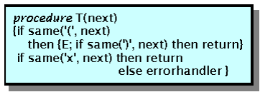
Recursive Decent Parsing...
In order to recognize a T, the parser must figure out which of the productions to execute.
In this routine, the parser determines whether T had the form (E) or x.
If not then the error routine was called, otherwise the appropriate terminals and non-terminals were recognized.

Slide 37
Recursive Decent Parsing...
So, all one needs to write a recursive descent parser is a nice grammar.
But, what exactly is a 'nice' grammar?
STAY TUNED TILL NEXT LESSON.

Slide 38
Thank You

